Slide 1
Learner Outcome
You will analyze and identify art from 3 periods, classical, medieval, and renaissance.

Slide 2
Entrance Slip
Identify 3 Machiavellian Principles that a good ruler should have.

Slide 3
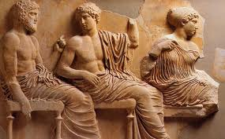
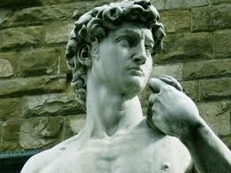
Classical Period 500B.C. – 500A.D.
Forms of Art: Sculpture, Painted pottery, murals, mosaics
Purpose: to show the importance of people and leaders, as well as gods and goddesses.
Characteristics of Classical Art: face look perfect, bodies look active, move convincingly, bodies are often nude, sometimes have togas, faces are calm/no emotion, scenes show heroic figures of real people doing daily tasks, little background (distant objects-smaller further away.)

Slide 4
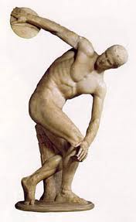
Classical Art
Daily task
Calm/ No emotion
Looks Perfect/Idealized/
Active Body
Bodies often nude
No Background
Discobolus of Myron

Slide 5
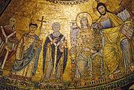
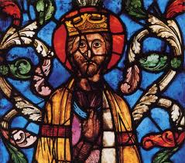
Medieval Art 500-1400A.D.
Forms of Art: Stained glass window, sculptures, illuminated, manuscripts, paintings
Purposes: to teach religion to people who cannot read/write
Characteristics: subjects look religious, figures look flat and stiff/little movement, important figures are large, fully clothed, stiff looking clothes, faces are solemn/little emotion, backgrounds single color, often gold, no realistic space

Slide 6
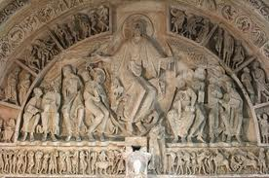
Medieval Art
Subjects Religious
Little emotion
Figures look kind of flat
Bodies fully clothed
Little Background
Uses more detail than classical

Slide 7
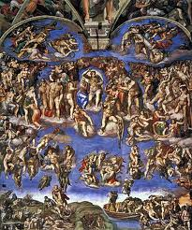
Renaissance 1400A.D.-1650A.D.
Forms: Sculptures, Murals, drawings paintings
Purpose: to show importance of people and nature, not just religion
Characteristics: religious and non religious, figures look perfect, bodies may look active, bodies may be clothed or nude, real people doing real task, colors respond to light that falls on them, interest in nature, full deep backgrounds, paintings symmetrical.

Slide 8
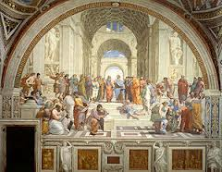
Renaissance Art
Daily task/ Movement
Expression on faces- hard to see in pic ☺
Looks Perfect/Idealized/
Active Body
Bodies covered
Lots of background/color

Slide 9
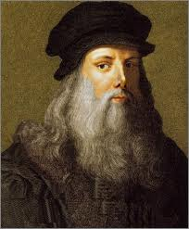
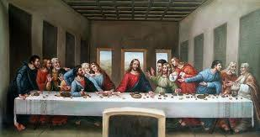
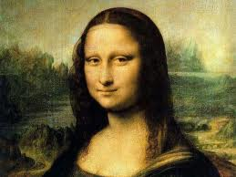
Leonardo Da Vinci
Painter
Architect
Engineer
“The Renaissance Man”
It had long since come to my attention that people of accomplishment rarely sat back and let things happen to them. They went out and happened to things.
Mona Lisa

Slide 10
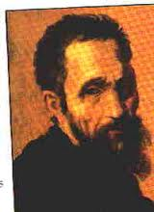
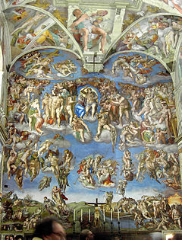
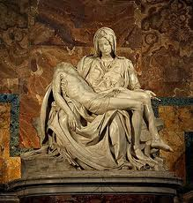
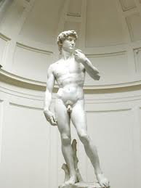
Michelangelo
Painter
The Sistine Chapel, Pieta, and
David were some of his best work.

Slide 11
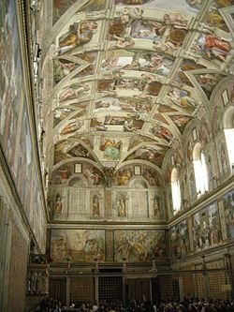
Sistine Chapel Rome Italy

Slide 12
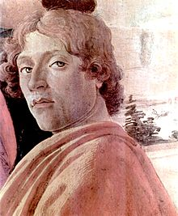
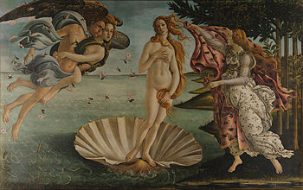
Sandro Botticelli
Famous Painter during the Early Renaissance
Birth of Venus

Slide 13
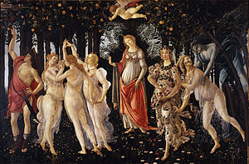

Slide 14
Learning Stations
You will analyze art from all 3 time periods.
You will study the art and determine which era it came from using your art characteristics guide.

Slide 15
Exit Slip
It will be handed out to you ☺

