Slide 1
Learner Outcome
Students will interpret the meaning of renaissance and explain the causes of the Italian Renaissance.

Slide 2
How did the Black Plague impact Europe. Give 2 negative examples and 2 positive examples.

Slide 3
Renaissance
A rebirth

Slide 4
A rebirth of what?

Slide 5
Where did it start?

Slide 6
ITALY

Slide 7
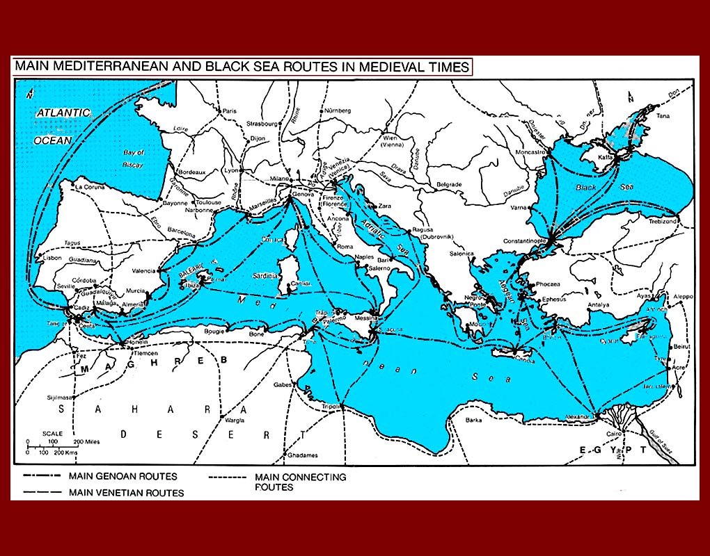
1. Italy was the geographic center of the Mediterranean trade.

Slide 8
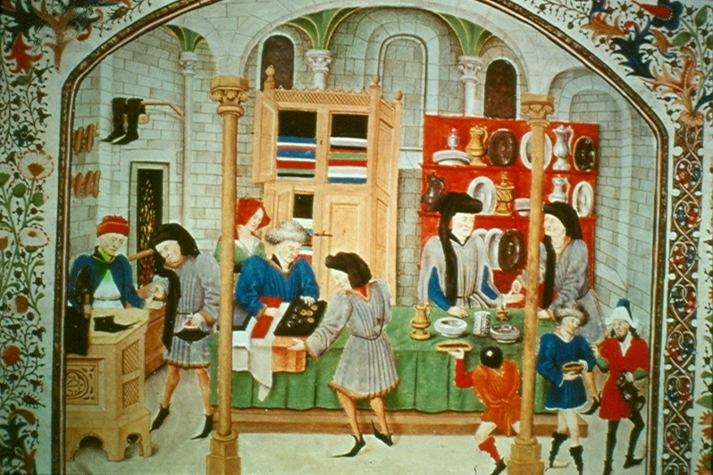
2. Italy had a wealthy merchant class that had a great deal of power and influence. Showed off their wealth and individualism.

Slide 9
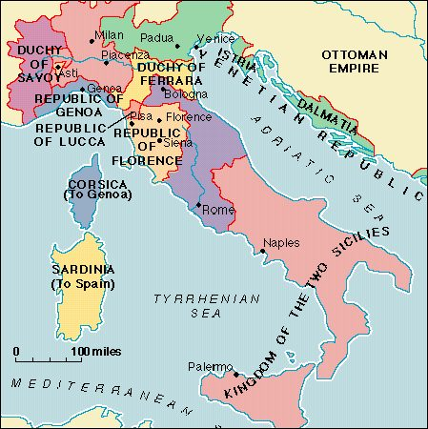
3. Italy had large independent city-states dominated by non-religious figures and not one central power (such as a king or priest).

Slide 10
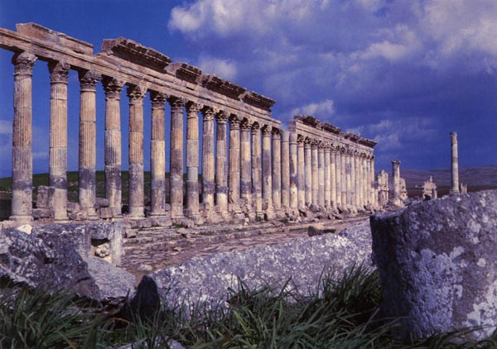
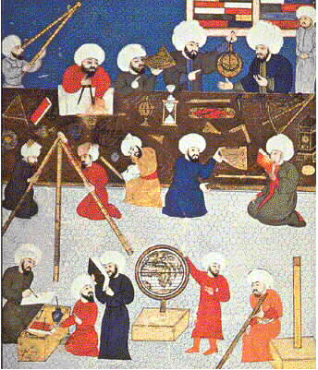
4. Roman ruins were located in Italy (buildings, arches, amphitheatres) and scholars moved there to study them. Additionally, Italians had the greatest amount of communication through trade routes with the advanced Islamic Civilizations.

Slide 11
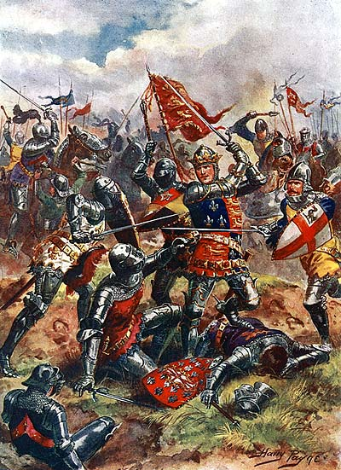
5. Many other countries were either fighting or involved in the Hundred Years’ War.

Slide 12
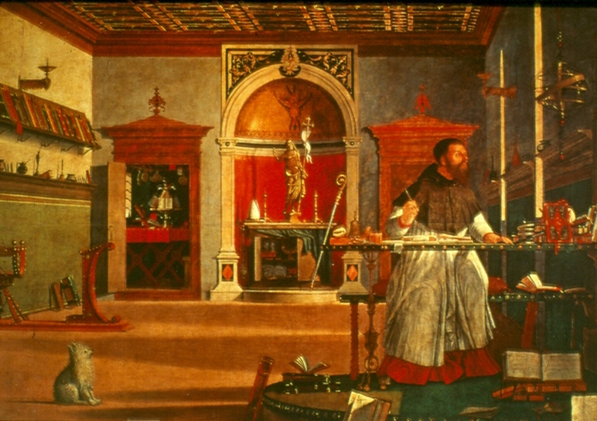
6. Italy was the center for the Catholic Church, its clergy, and the wealth they wanted to flaunt.

Slide 13
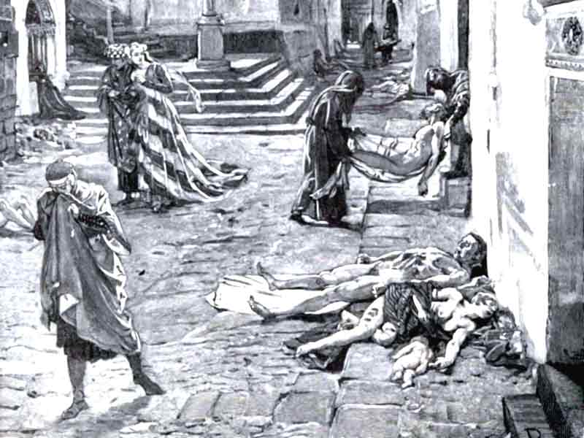
7. The Black Death wiped out almost ½ of Italians in 1348. The clergy’s attempt to cure the people were unsuccessful and the per capita wealth increased greatly (each person had more disposable income because there were less people alive).
People quit turning to the church for answers, they began to think and take care of themselves

Slide 14
Using the facts about Italy, determine how or why each Renaissance ideal could flourish there.
HUMANISM –
SECULARISM –
INDIVIDUALISM –

Slide 15
Using the facts about Italy, determine how or why each Renaissance ideal could flourish there.
HUMANISM –
Roman ruins were located there (buildings, arches, amphitheaters); Daily reminder of the Classical Romans; Part of their past and their traditions
SECULARISM –
Large independent city-states/town life; non-religious leaders dominated
Wealthy merchant class; Wealth and ability mattered more than titles and ownership of land.
INDIVIDUALISM –
Wealthy merchant class; Used their money to support artists, philosophers, writers
Black Death led people to focus on life and their human potential

Slide 16
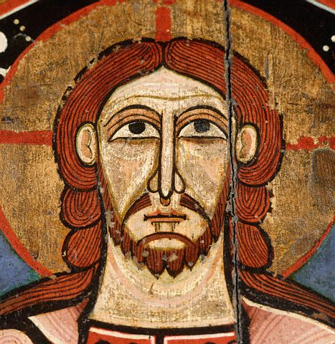
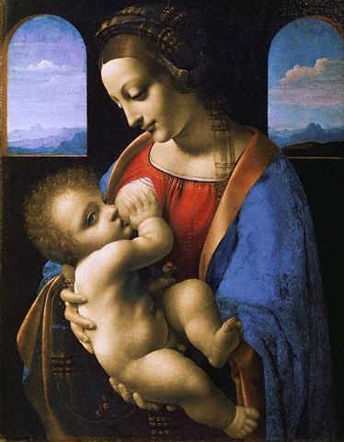
The Renaissance produced new ideas that were reflected in the arts, philosophy, and literature.
Patrons, wealthy from newly expanded trade, sponsored works which glorified city-states in northern Italy. Education became increasingly secular.
Medieval art and literature focused on the Church and salvation
Renaissance art and literature focused on individuals and worldly matters, along with Christianity.

Slide 17
Renaissance Artists embraced some of the ideals of Greece and Rome in their art
They wanted their subjects to be realistic and focused on humanity and emotion
New Techniques also emerged
Frescos: Painting done on wet plaster became popular because it gave depth to the paintings
Sculpture emphasized realism and the human form
Architecture reached new heights of design

Slide 18
Born in 1475 in a small town near Florence, is considered to be one of the most inspired men who ever lived

Slide 19
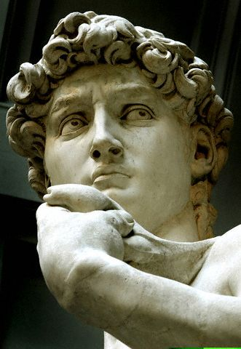
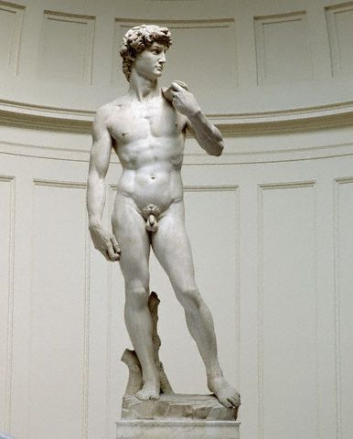
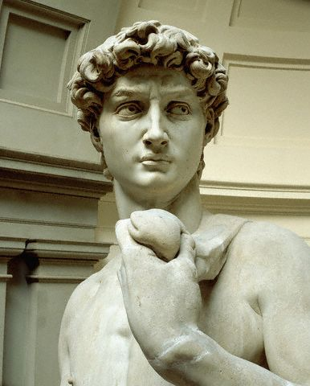
David
Michelangelo created his masterpiece David in 1504.

Slide 20
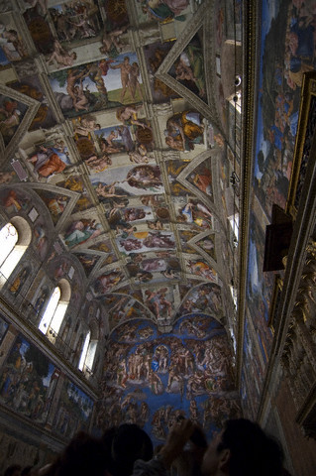
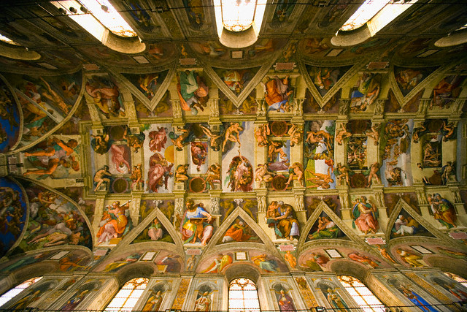
Sistine Chapel
About a year after creating David, Pope Julius II summoned Michelangelo to Rome to work on his most famous project, the ceiling of the Sistine Chapel.

Slide 21
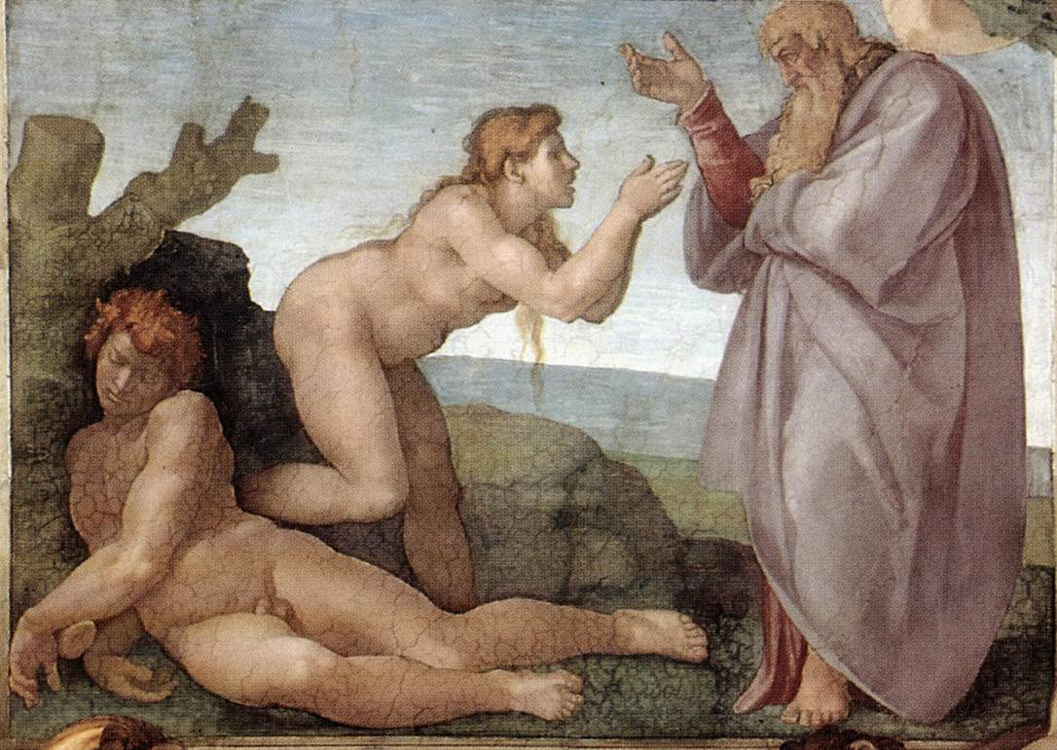
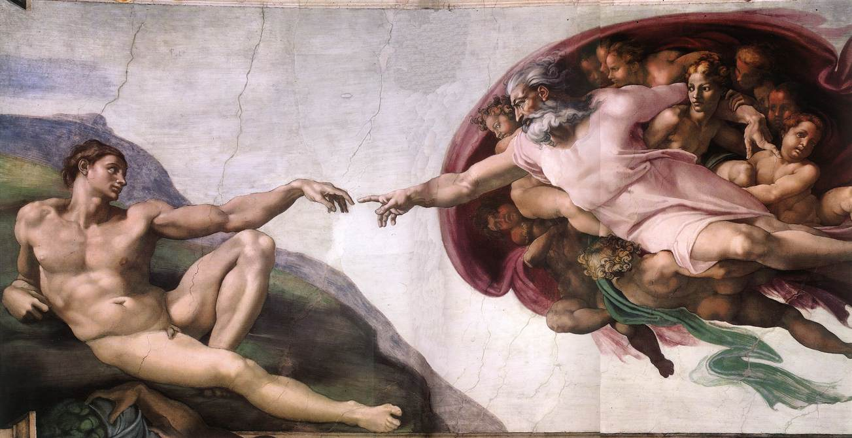
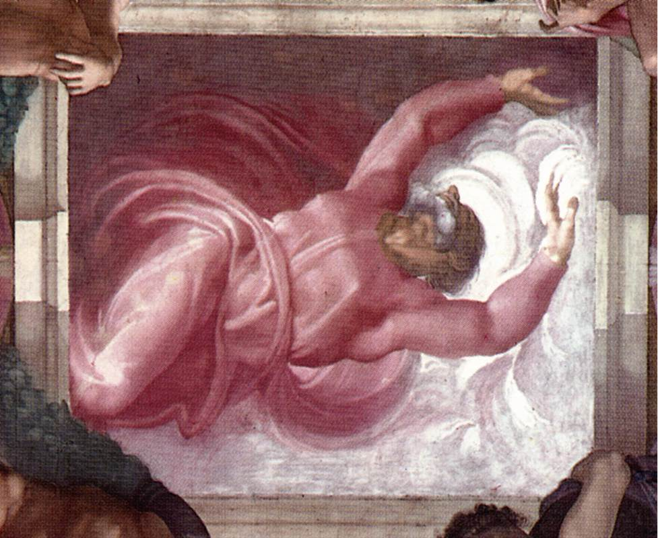
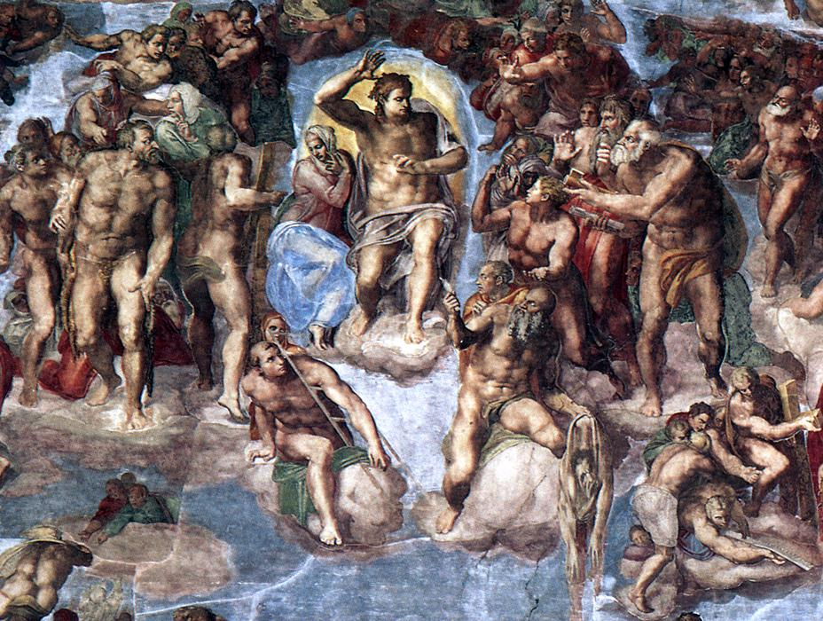
Creation of Eve
Creation of Adam
Separation of Light and Darkness
The Last Judgment

Slide 22
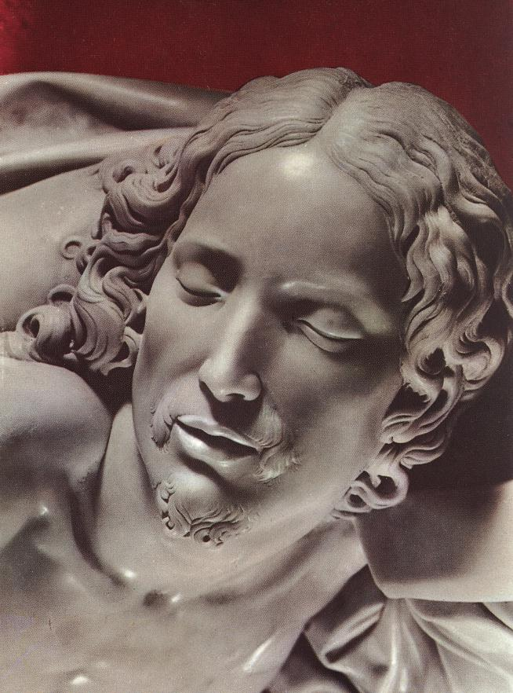
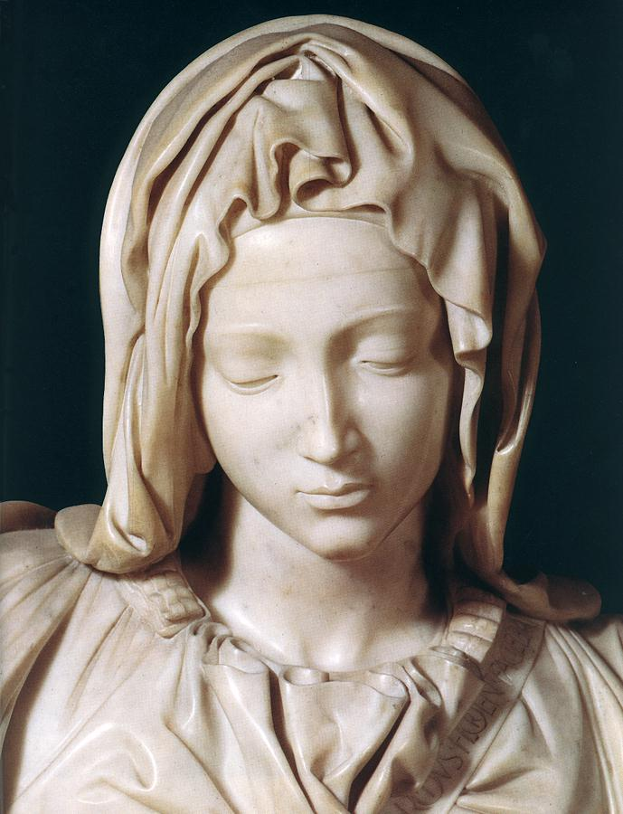
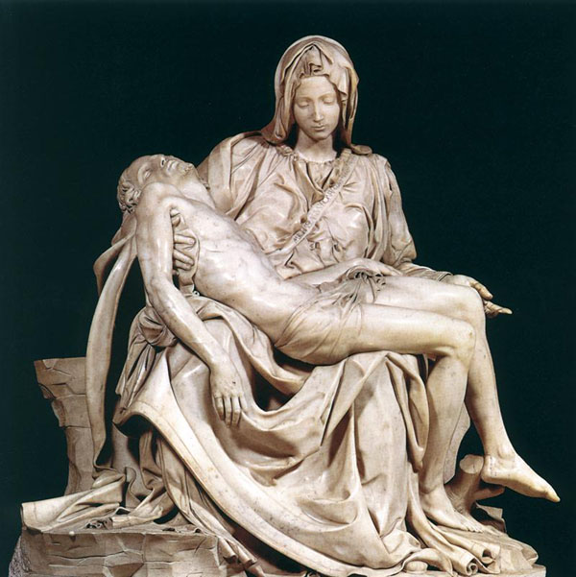
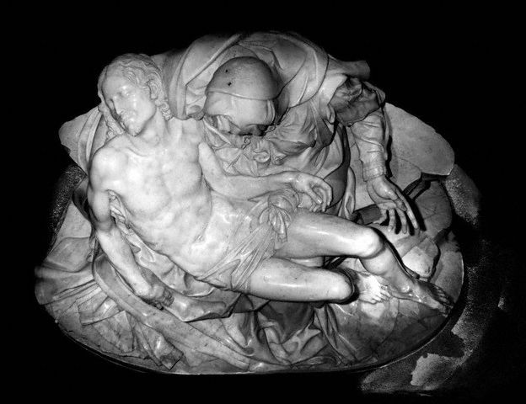
La Pieta 1499 Marble Sculpture

Slide 23
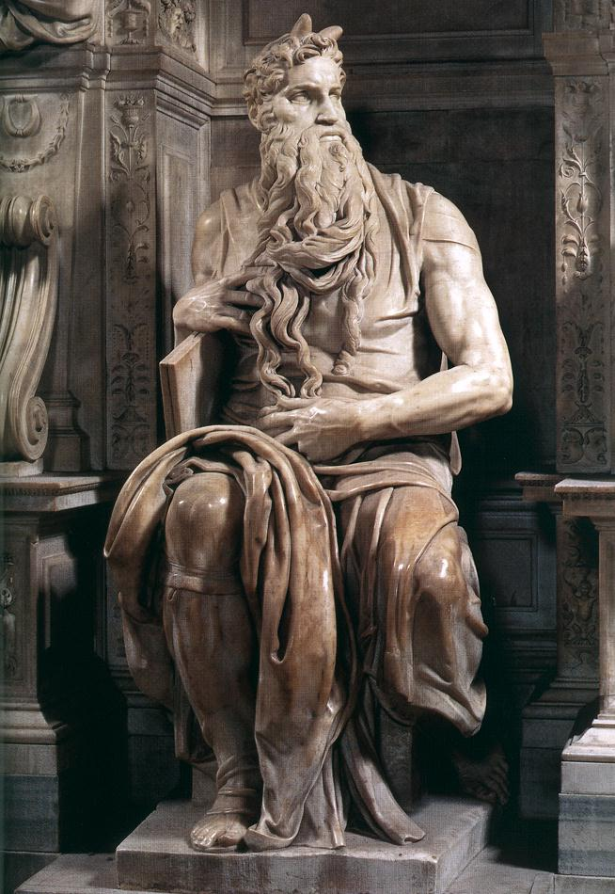
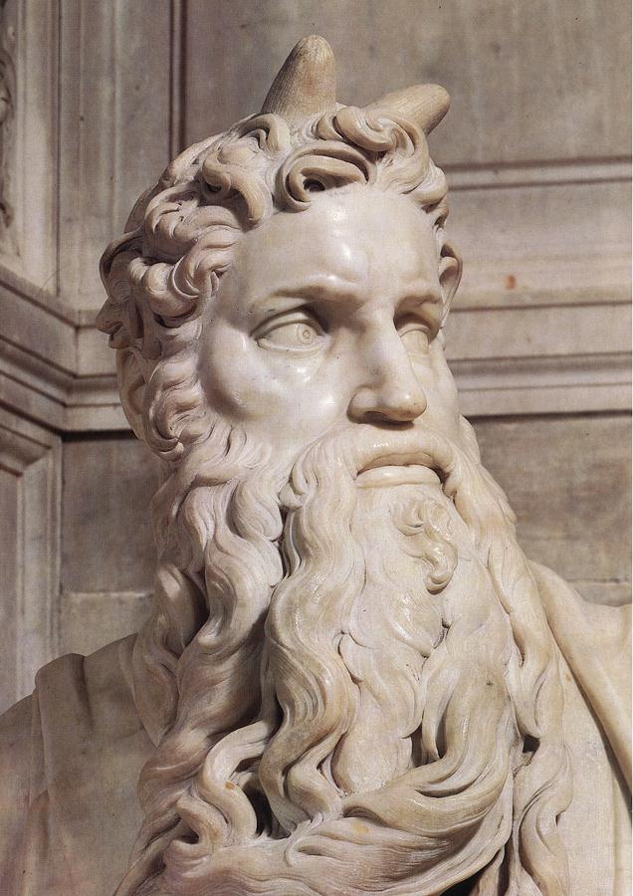
Moses

Slide 24
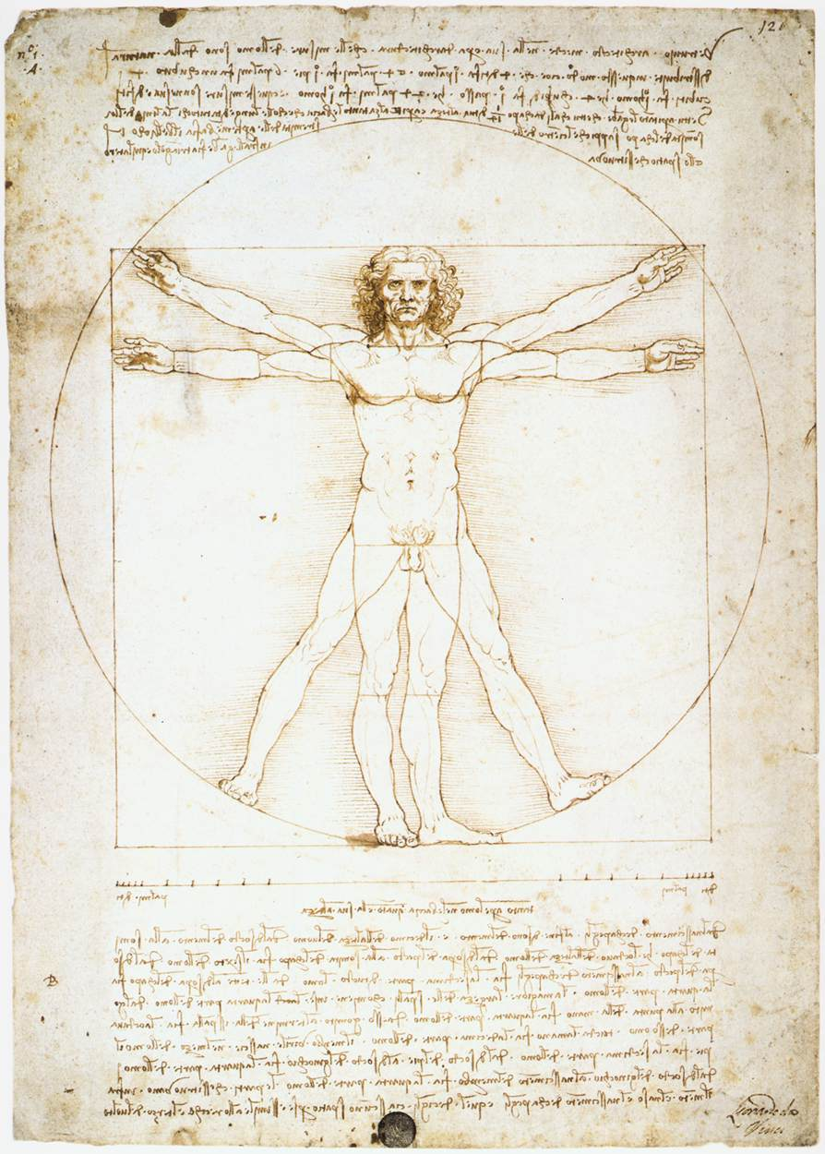
1452-1519
Painter, Sculptor, Architect, Engineer
Genius!

Slide 25
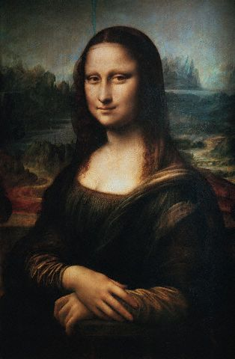
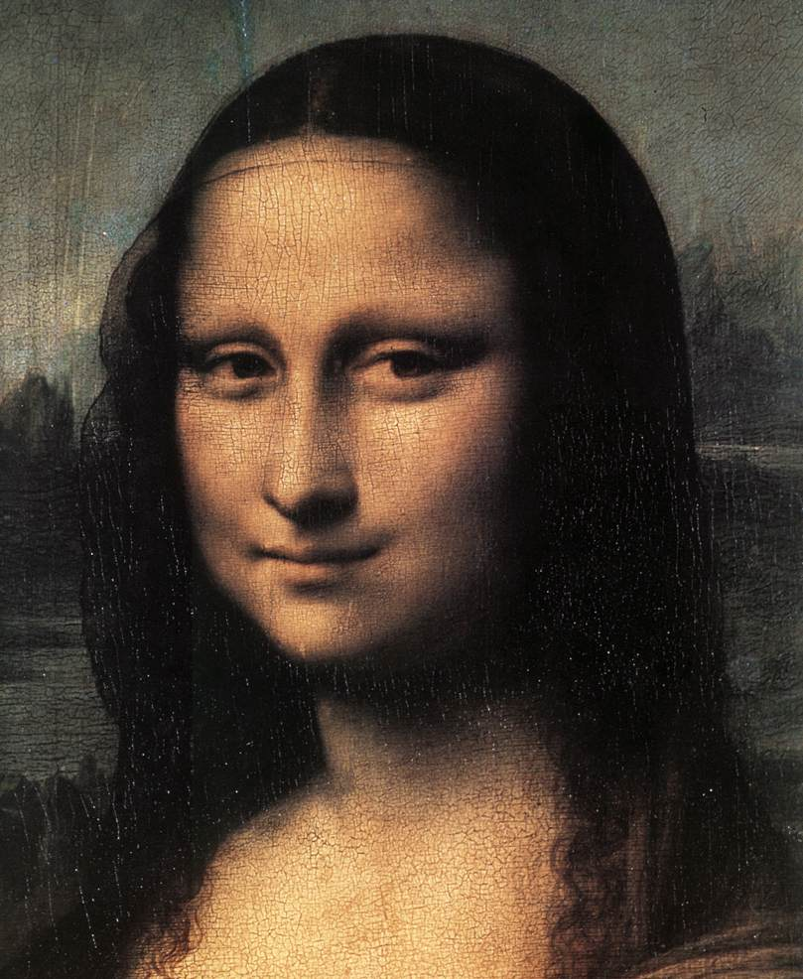
Mona Lisa

Slide 26
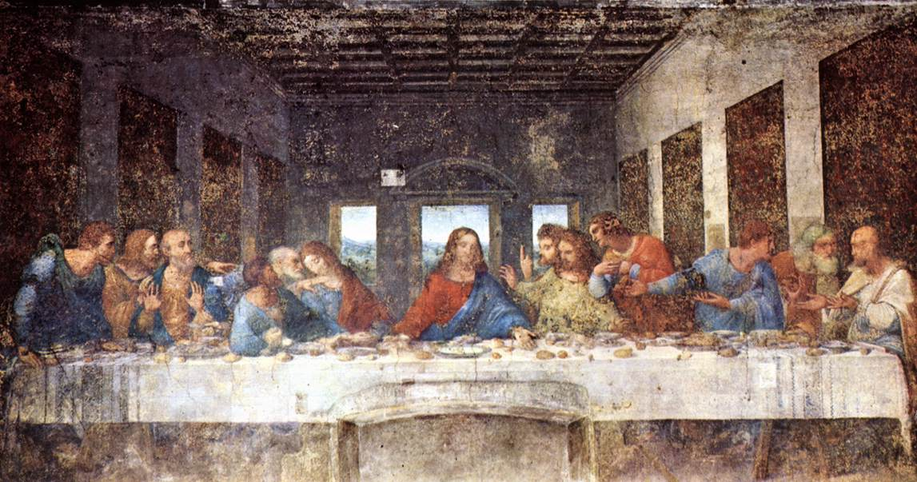
The Last Supper

Slide 27
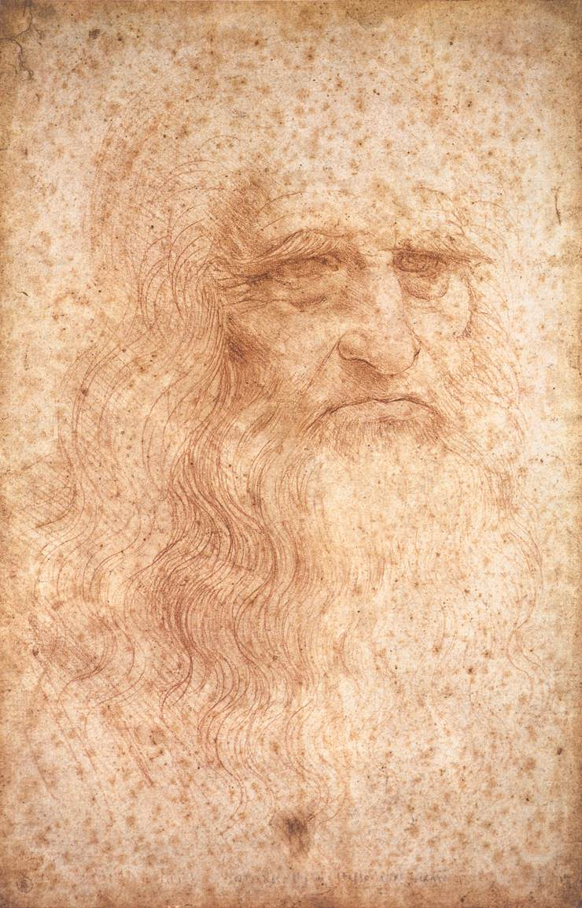
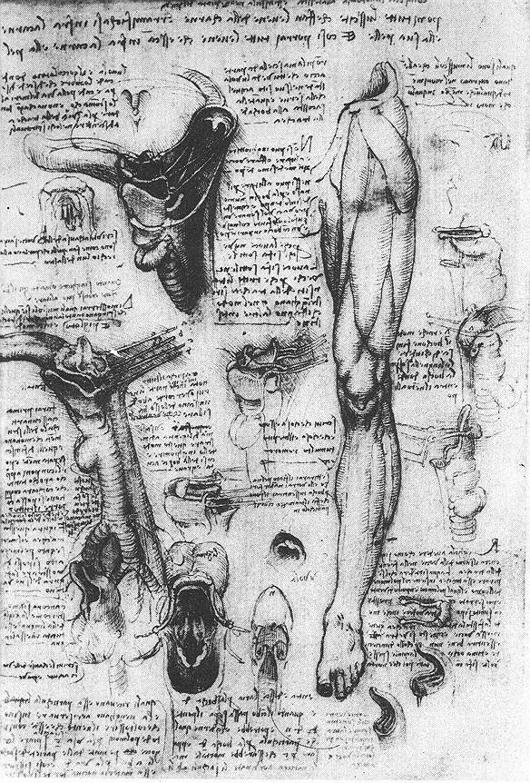
Notebooks

Slide 28
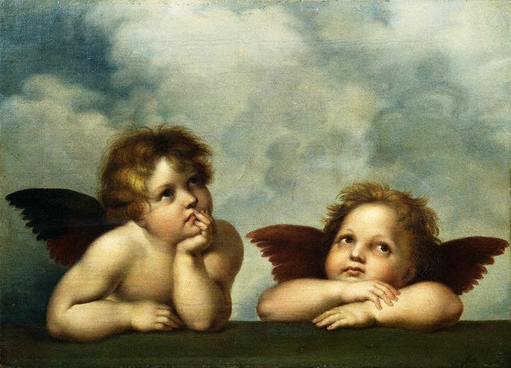
Painter Raphael - 1483-1520

Slide 29
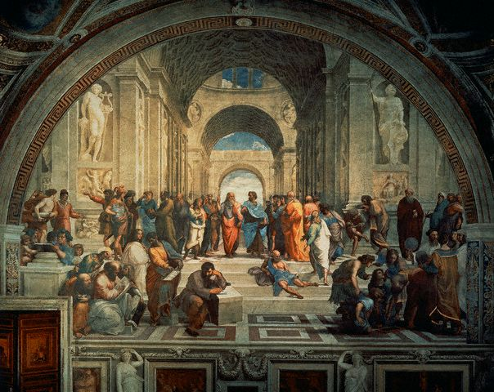
The School of Athens

Slide 30
Medici Family
Cosimo the Elder (top), the Patriarch of the family started the Renaissance by reintroducing Plato and humanists thinking.
Lorenzo the Magnificent (bottom),was known to many as the Father of the Renaissance. He sponsored writers, artists, sculptors, painters and philosophers.

Slide 31
Medici’s Video

Slide 32
Exit Slips – Answer the causes of the Renaissance and the Secularism, humanism and individualism.

Slide 33
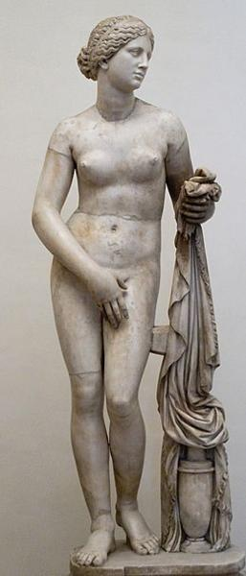
Classical Art
Characteristics of Art:
Figures look idealized, perfect
Bodies are often nude or draped in togas
Faces are bland, calm, without emotion
Scenes and subjects show heroic figures or real people doing real tasks of daily life
Little background or sense of perspective (when distant objects look far away
Bodies look active, move convincingly
Disproportionate depictions of the human body in murals and mosaics

Slide 34
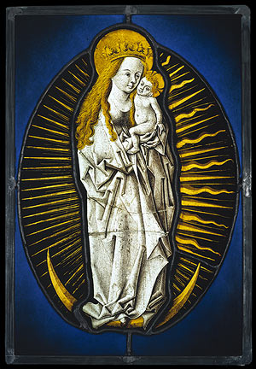
Medieval Art
Characteristics of Art:
Figures look flat and stiff with little real movement
Bodies are fully clothed, draped in stiff looking clothing
Faces are solemn with little emotion
Scenes and subjects show Biblical figures and leaders doings tasks to glorify God
Flat, two-dimensional figures
Backgrounds a single color, often gold
Disproportionate depictions of the human body

Slide 35
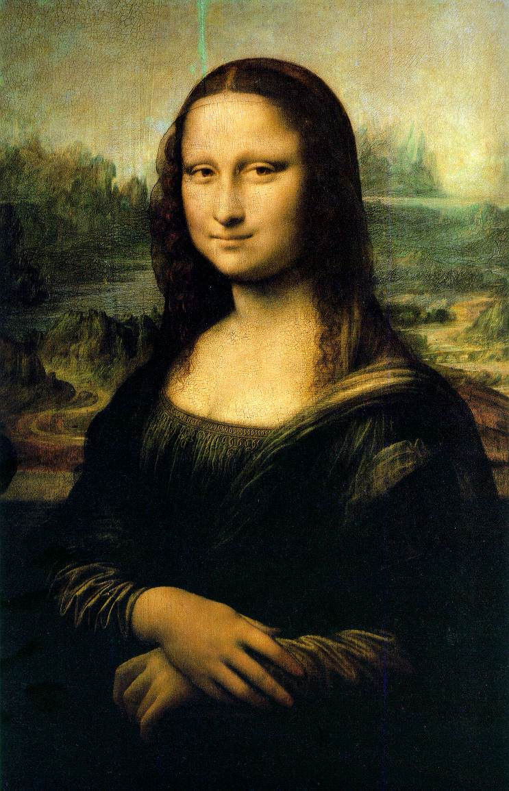
Renaissance Art
Characteristics of Art:
Figures look idealized, perfect
Bodies may be nude or clothed
Faces are express what people are thinking
Scenes and subjects show religious, pagan and secular (non-religious) scenes
Full, deep backgrounds with perspective
Paintings are symmetrical
Paintings look to emphasize chiaroscuro (colors respond to the light that falls on them)
Interest in nature, lots of natural detail
Realistic and proportionate depictions of the human body

